Slide 1


Slide 2

UNIVERSITY ADMISSION MANAGEMENT SYSTEM
GROUP MEMBERS:
1.AYESHA RAFIQ 21-SE-039
2.LAIBA SAEED 21-SE-053
3.SYEDA AIMEN FATIMA 21-SE-055

Slide 3
PURPOSE:
In a fast-growing, global village, there is a need of an effective and efficient education system.
When universities embrace the use of a student application management system, a lot more can be executed with less effort. The main purpose of the student management system is as follows
Admission process becomes easier.
Accuracy in managing the information of students.
Gives education institute a global reach.

Slide 4
Objective:
The major objective of this project are as follows
To create a simple form submitting system
To store the information of the students and manage them.
Only valid users who passed the entrance exam can fill up the form.
Allows the administrator to view the information

Slide 5
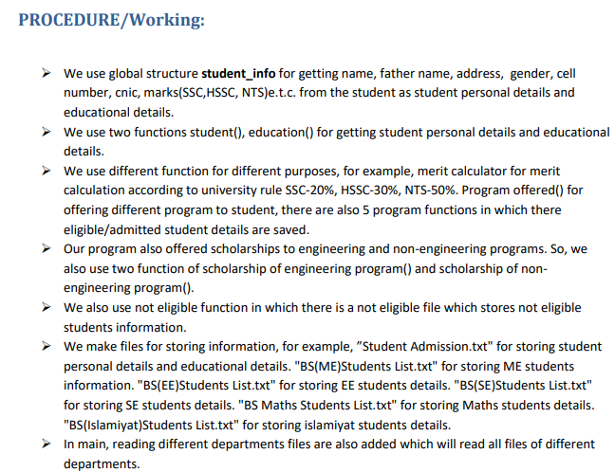

Slide 6
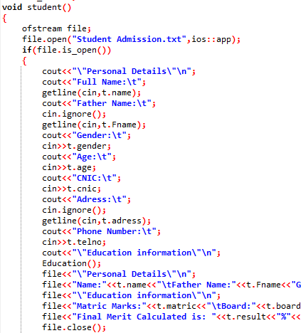
Saving student information in file
Student enters his personal details and they are saved in file(student admission)

Slide 7
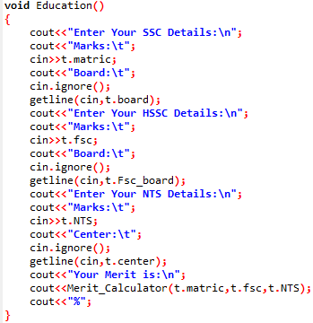

Entering educational details and merit calculation
Student enters marks and merit is calculated by formula through merit calculator function.

Slide 8
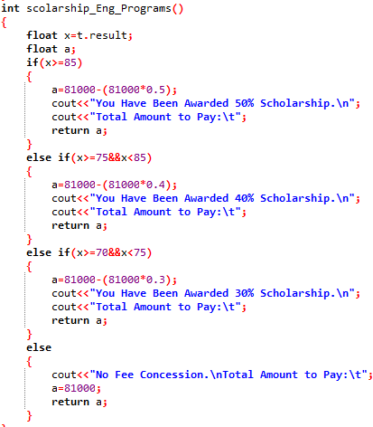
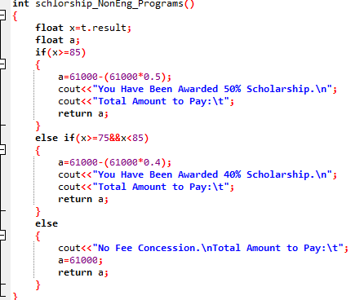
Schlorship For engineering and non eng programs:

Slide 9
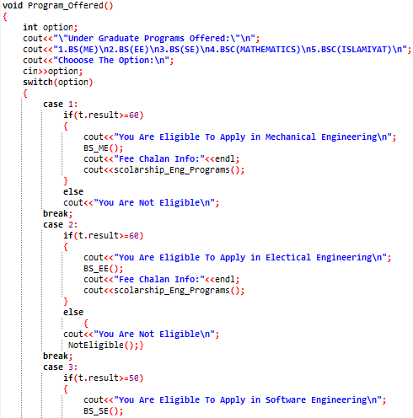
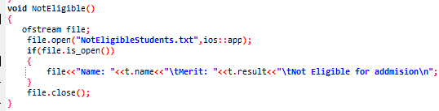
Checking eligibility criteria and entering students in different departments also keeping record of admitted and non admitted students.
storing record of admitted and non admitted students in files through functions.

Slide 10
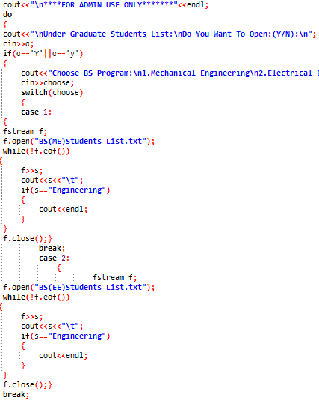
Project is divided into 2 sections:
1.UNIVERSITY ADMISSION FORM(That is for student use)
2.STUDENTS LIST OF ALL DEPARTMENTS(for admin use only)
Displaying students list of different departments

Slide 11
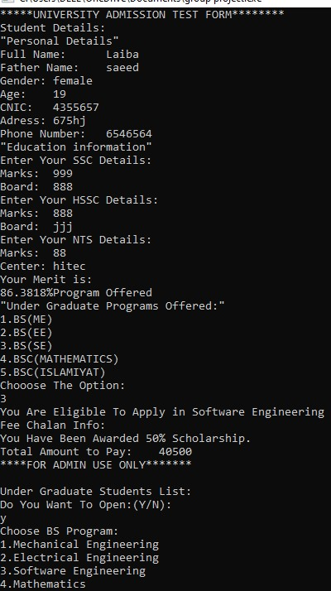
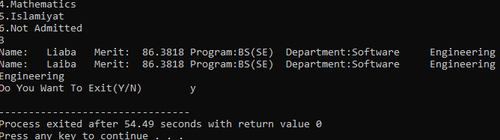
OUTPUT OF PROGRAM:

Slide 12

Thank You
someone@example.com

